Slide 1
COMP 51 Week Fourteen
Intro to C#

Slide 2
Learning Objectives
C#
Intro to new programming language
Variant of C++ and Java
Oriented towards Graphical User Interfaces

Slide 3
Why Do We Care
Learn new languages and frameworks
Most applications have user interfaces which require advanced libraries
Understand “event driven” programming

Slide 4
What is C#
Child of C/C++
Close to Java in concept
Graphical User Interface (GUI) Oriented Language
Windows Forms
Web Pages
Compile to machine independent code

Slide 5
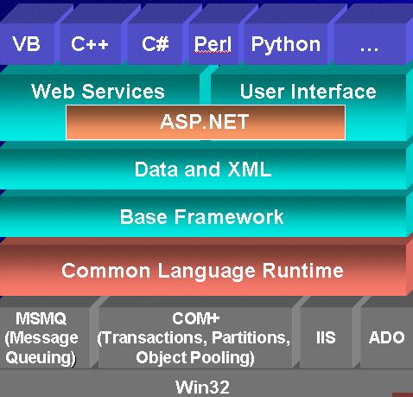
.net and C#
So far we’ve been coding at this level

Slide 6
Some C# Differences
No header files
Class and function definition location independent
No global functions or constants
Everything belongs in class
Arrays have built in bounds checking and length calculation
Always use '.', no more '->' or '::' operators

Slide 7
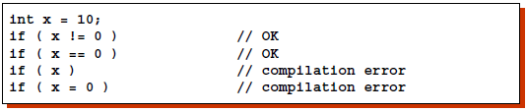
Program Flow Differences
All condition expressions must evaluate to a bool type
Switch
Can use string data types as test variable
No fall through to next case

Slide 8
Organization of C# Code
A sample Form.cs:
The using directives indicate which namespaces of .NET Framework this program will use.
The user-defined namespace of the project not .NET Framework namespaces
Class declaration
A method
using System;
using System.Collections.Generic;
using System.ComponentModel;
using System.Data;
using System.Drawing;
using System.Linq;
using System.Text;
using System.Windows.Forms;
namespace Hello_World
{
public partial class Form1 : Form
{
public Form1()
{
InitializeComponent();
}
}
}
1
2
3
4
Notes:
C# code is organized as methods, which are contained inside classes, which are contained inside namespaces

Slide 9
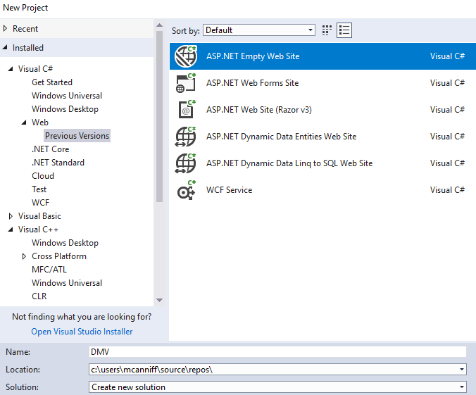
Getting Started
Change VisualStudio to C# environment
Tools → Import and Export Settings → Reset
Choose Web Development
Create a new project
File → New Project...
Visual C# → Web → Previous Version
Choose ASP.NET Empty Web Site
Name = change website1 to DMV
Create first page
File → New file → Web Form
Make sure that Visual C# is highlighted. Press Add

Slide 10

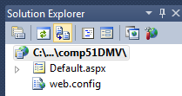

Visual Studio Web Page Navigation
Note – Play icon launches page om default browser
Should see the default page just created
Click on Design view to see web page. Add a Header to the page

Slide 11
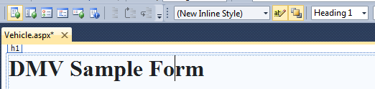
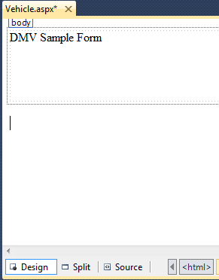
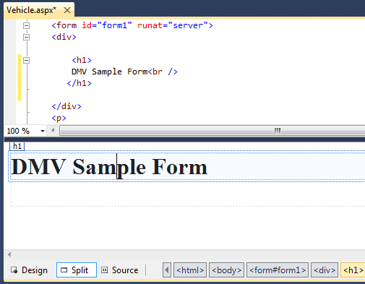
HTML Intro
Change to a Heading level
Type in a title for the page
Switch to Split View. Note the HTML tags in the source window

Slide 12
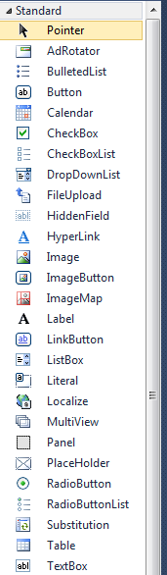
Add Text Boxes
Provide Prompts
Type FirstName, LastName, Address on newlines
Hit enter to put on new lines
Add the following text boxes
FirstName, LastName, Address
Add a Tooltip to prompt the user
Hint – Look in properties area for tooltip
Make Last Name bold.
Hint – Same as you would in Word
Drag a text box onto the page

Slide 13
Adding Your Code
GUI applications are event-driven which means they interact with users
An event is a user’s action such as mouse clicking, key pressing, etc.
Double clicking a control, such as Button, will link the control to a default Event Handler
An event handler is a method that executes when a specific event takes place
A code segment similar to the following will be created automatically:
private void myButton_Click(object sender, EventArgs e)
{
}

Slide 14
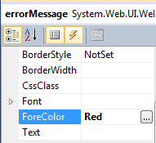
Updating Fields and Labels
Similar to C++ class assignment statements
Drag a Label to the bottom of the page
Set ID = errorMessage
Blank out the text
Set the foreground color to red

Slide 15
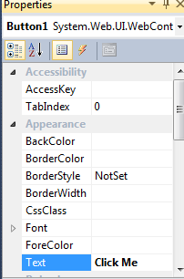
Add an Action - Button
Drag a Button onto bottom of page
Change Text = Click Me
Double click on the button (or press enter)
This should create a new tab/page called default.cs
In the method Button1_Click, type:
errorMessage.Text = "Thanks for clicking";

Slide 16
Message Boxes
A message box (aka dialog box) displays a message
The .NET Framework provides a method named MessageBox.Show
C# can use it to pop up a window and display a message. A sample code is (bold line):
private void myButton_Click(object sender, EventArgs e)
{
MessageBox.Show(“Thanks for clicking the button!”);
}
Notes:
This is only for Windows forms.

Slide 17
Convert String to Numeric Values
Input collected from the keyboard are considered combinations of characters (or string literals) even if they look like a number to you
A TextBox control reads keyboard input, such as 25.65. However, the TextBox treats it as a string, not a number.
In C#, use the following Parse methods to convert string to numeric data types
int.Parse
double.Parse
decimal.Parse
Examples:
int hoursWorked = int.Parse(hoursWorkedTextBox1.Text);
double temperature = double.Parse(temperatureTextBox.Text);
Notice that int and double are now class definitions

Slide 18
Convert Numeric to String Values
The Text property of a control only accepts string literals
To display a number in a TextBox or Label control requires you to convert a numeric data to string type
In C#, all variables work with ToString method that can convert variables’ values to string:
Double grossPay = 1550.0;
grossPayLabel.Text = grossPay.ToString();
int myNumber = 123;
MessageBox.Show(myNumber.ToString());
Another option is “implicit string conversion with the + operator”:
int idNumber = 1044;
String output = “Your ID number is “ + idNumber;
This is an example of operator overloading

Slide 19
Formatting Numbers
The ToString method can optionally format a number to appear in a specific way
The following table lists the “format strings” and how they work with sample outputs
Format String | Description | Number | ToString() | Result
“N” or “n” | Number format | 12.3 | ToString(“n3”) | 12.300
“F” or “f” | Fixed-point scientific format | 123456.0 | ToString("f2") | 123456.00
“E” or “e” | Exponential scientific format | 123456.0 | ToString("e3") | 1.235e+005
“C” or “c” | Currency format | -1234567.8 | ToString("C") | ($1,234,567.80)
“P” or “p” | Percentage format | .234 | ToString("P") | 23.40%

Slide 20
Exception Handling
An exception is an unexpected error that happens while a program is running
If an exception is not handled by the program, the program will abruptly halt
C# allows you to write codes that responds to exceptions. Such codes are known as exception handlers.
In C# the structure is called a try-catch statement
try { }
catch { }
The try block is where you place the statements that could have exception
The catch block is where you place statements as response to the exception when it happens

Slide 21
Calculate MPG Practice
Add three more text boxes to page
Miles, gallons, mileage
Make sure to change IDs to match code in notes section.
Change the mileage to display only
Set property enabled = false
Change button text = “Calculate Mileage”
Switch back to your default.cs file
Remove the previous errorMessage code
Paste the code from the notes below
Notes:
try
{
double miles;
double gallons;
double mpg;
miles = double.Parse(milesTextBox.Text);
gallons = double.Parse(gallonsTextBox.Text);
mpg = miles / gallons;
mpgTextBox.Text = mpg.ToString();
}
catch
{
errorMessage.Text = “Need to provide a value for Gallons";
}

Slide 22
Throwing an Exception
In the following example, the user may entered invalid data (e.g. null) to the milesText control. In this case, an exception happens (which is commonly said to “throw an exception”).
The program then jumps to the catch block.
You can use the following
to display an exception’s
default error message:
catch (Exception ex)
{
MessageBox.Show(ex.Message);
}
try
{
double miles;
double gallons;
double mpg;
miles = double.Parse(milesTextBox.Text);
gallons = double.Parse(gallonsTextBox.Text);
mpg = miles / gallons;
mpgLabel.Text = mpg.ToString();
}
catch
{
MessageBox.Show("Invalid data was entered."):
}

Slide 23
Preventing Data Conversion Exception
Exception should be prevented when possible
The TryParse methods can prevent exceptions caused by users entering invalid data
int.TryParse
doubel.TryParse
decimal.TryParse
The generic syntax is:
int.TryParse(string, out targetVariable)
The out keyword is required; it specifies that the targetVariable is an output variable

Slide 24
Samples of TryParse Methods
// int.TryParse
int number;
if (int.TryParse(inputTextBox.Text, out number)) { } else { }
//double.TryParse
double number;
if (double.TryParse(inputTextBox.Text, out number)) { } else { }
//decimal.TryParse
decimal number;
if (decimal.TryParse(inputTextBox.Text, out number)) { } else { }

Slide 25

RadioButton Control
Ability to turn off/on selections
Common properties are:
Text: holds the text that is displayed next to the radio button
Checked: a Boolean property that determines whether the control is selected or deselected
In code, use a decision structure to determine whether a RadioButton is selected. For example,
If (choiceRadioButton.Checked) { } else { }

Slide 26
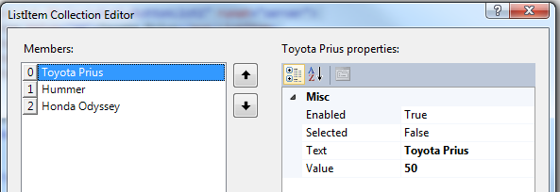
Radio Button Lists
Supports a group of related options
Only one option may be selected
Update your DMV Code
After the gallons field, insert a few blank lines
Drag a RadioButtonList control to the blank space
Set id = autoRadioButtonList
Click on the > symbol (smart tag). Choose Edit Items
Press Add for the following. Then press OK
Text = Toyota Prius, Value = 10
Text = Honda Odyssey, Value = 16
Text = Hummer, Value = 20
Other???

Slide 27
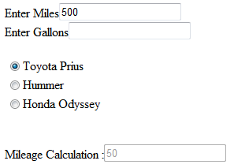
Accessing Selected Radio Logic
Assume that the RadioButtonList has tank size values.
Change gallons assignment to :
gallons = double.Parse(autoRadioButtonList.SelectedValue);
Make gallons a display only field (enabled = “false”)

Slide 28

CheckBox Control
The CheckBox Control gives the user an option, such as true/false or yes/no
Common properties are:
Text: holds the text that is displayed next to the radio button
Checked: a Boolean property that determines whether the control is selected or deselected
In code, use a decision structure to determine whether a CheckBox is selected. For example,
If (option1CheckBox.Checked) { } else { }
Notes:
Anything a RadioButton or a CheckBox control’s Checked property changes, a CheckedChanged event is raised
You can create a CheckedChanged event handler and write codes to respond to the event
Double click the control in the Designer to create an empty CheckedChanged event handler similar to:
private void yellowRadioButton_CheckedChanged(object sender, EventArgs e) { }

Slide 29
Declaring Custom Method Inside a Class
using System;
using System.Collections.Generic;
using System.ComponentModel;
using System.Data;
using System.Drawing;
using System.Linq;
using System.Text;
using System.Windows.Forms;
namespace Example
{
public partial class Form1 : Form
{
public Form1()
{
InitializeComponent();
}
// your method definition will appear here inside Form1 class
}
}
All Visual C# methods typically belong to applications’ default
private void goButton_Click(object sender, EventArgs e)
{
MessageBox.Show(“This is the goButton_Click method.”);
DisplayMessage();
}
private DisplayMessage()
{
MessageBox.Show(“This is the DisplayMessage method.”);
}
Method call

Slide 30
Passing Arguments by Reference
Concept same as C++
A reference parameter is a special type of parameter
It becomes a reference to the argument that was passed into it
When an argument is passed by reference to a method, the method can change the value of the argument in the calling part of the program
In C#, you use the ref keyword before the parameter variable’s data type
private void SetToZero(ref int number)
{
number =0;
}
To call a method with a reference parameter, you also use the keyword ref before the argument
int myVar = 99;
SetToZero(ref myVar);

Slide 31
Using Output Parameters
An output parameter works like a reference parameter with the following differences:
An argument does not have to be initialized before it is passed into an output parameter
A method that has an output parameter must be the output parameter to some value before it finishes executing
In C#, you use the out keyword before the parameter variable’s data type
private void SetToZero(out int number)
{
number = 0;
}
To call a method that has a output parameter, you also use the keyword out before the argument
int myVar;
SetToZero(out myVar);
Uninitialized variable

Slide 32
Key Takeaways
C#
Putting the “Visual” into VisualStudio and C++
Importance of knowing the (.Net) framework

